Slide 1
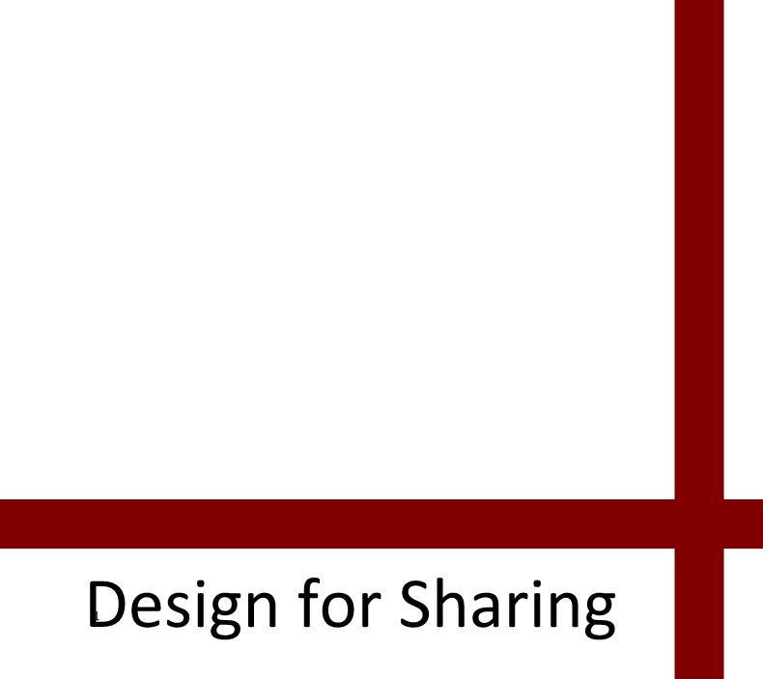
Ann Light
Professor of Design
Northumbria University

Slide 2
Share more… consume less

Slide 3
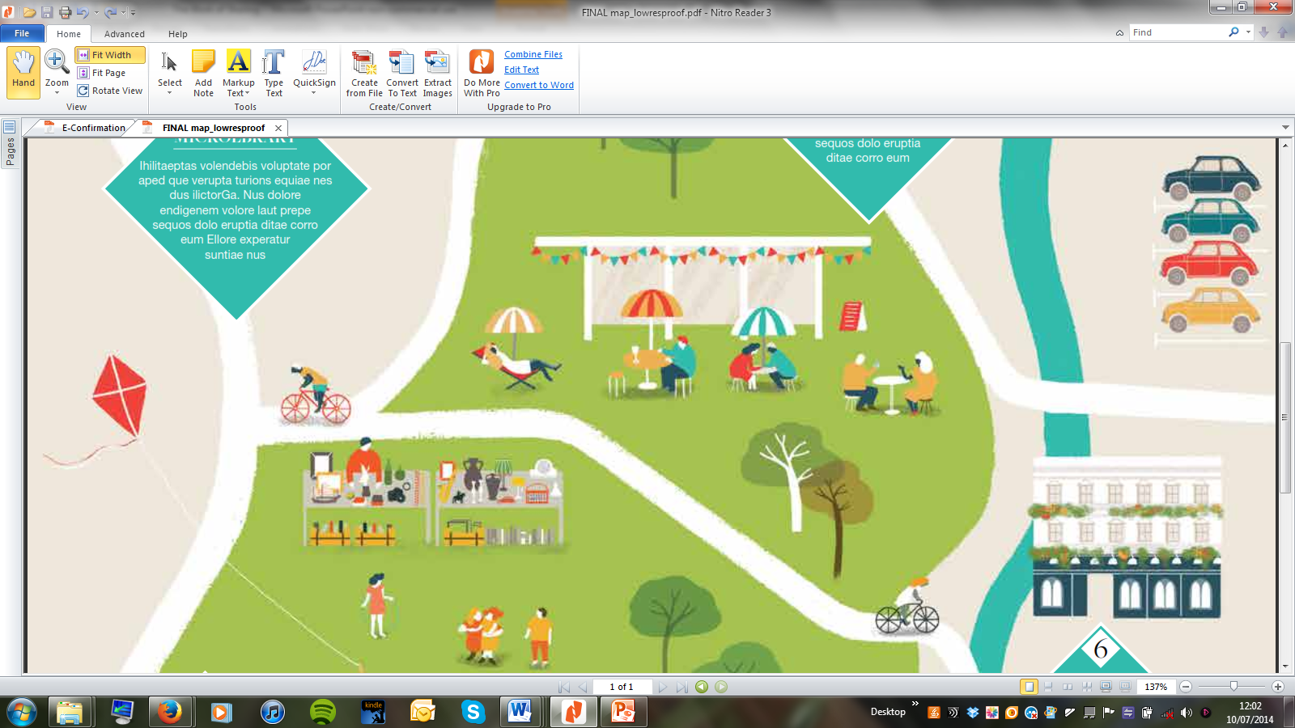
What do we share?

Slide 4
What do we share?
space, time, things, transport, skills, childcare, buying decisions, meals, celebration

Slide 5
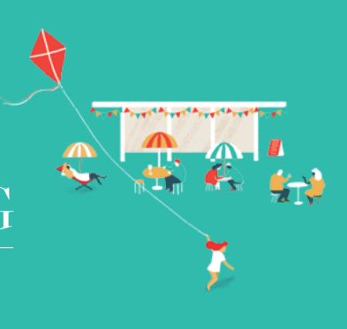
Teasing out 3 strands…
The report develops design strategies for sharing, promoting three different aspects of sustainability:
design for optimal resource management;
design for improved societal relations;
design for economic (global, national, local, communal) vitality.

Slide 6
Motivation
For sustainability…
We need cooperation and trust to weather difficult times;
We need gainful activities that give a sense of purpose;
We need positive framings rather than always avoiding something… spend less, waste less, consume less.

Slide 7
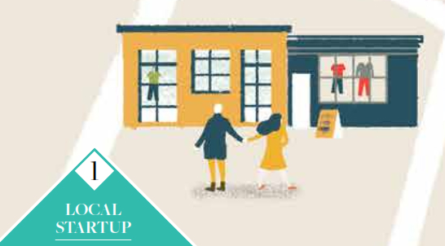
Flexible Dwellings for Extended Living (2012)
How do we want to dwell together (as we age)?
How can we share our spaces?

Slide 8
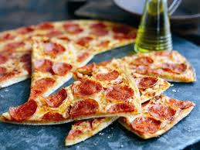
“I had ordered a pizza from the take-away, but there was a mix up and I got two pizzas instead of one. I said to Steve, ‘Give that to Andy’, and he’s, ‘Oh no, no, no, no’. So I just went and knocked on Andy’s door, and he happened to be in and he came out and I said, ‘Would you like this pizza? The pizzeria has given us this free. Do you like pepperoni?’. He said, ‘I do now’. And two days later, he said, ‘Oh, that was great, I really enjoyed my pizza’.”
Newcastle High Tea

Slide 9

Sharing:
New economy?
Or age-old sustainable practice?

Slide 10
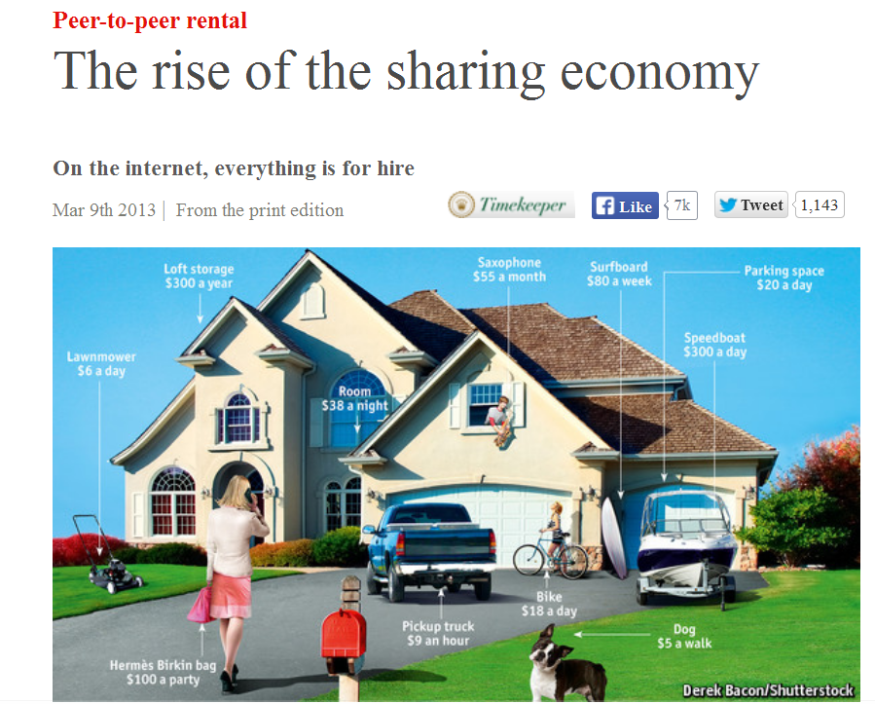

Slide 11
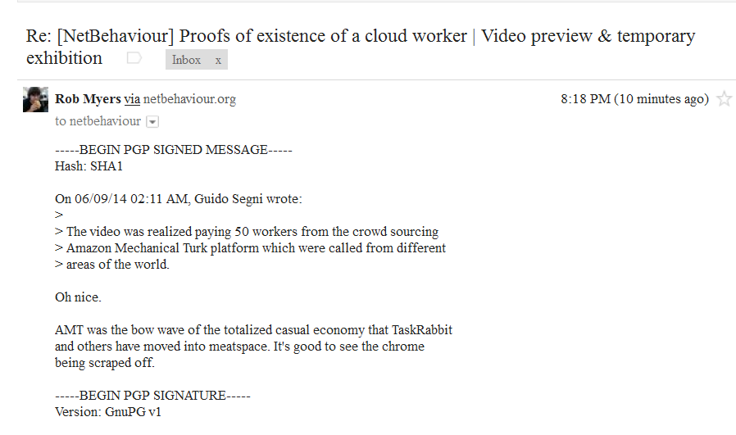
Sharing…?

Slide 12
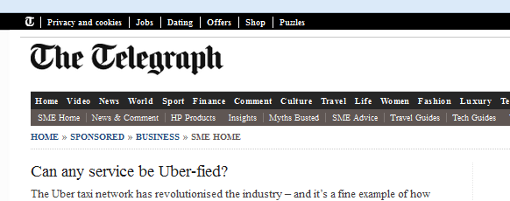
21st Oct 2014
“It is a prime example of how so-called convenience technology is creating the most disruptive start-ups in modern times.
Now worth an estimated $18bn (£11bn), Uber allows consumers to find a taxi using a hi-tech app and has been engineered to undercut existing services, such as the black cab that is seen in London and other major UK cities.
Moreover, it tells you your estimated fare before you travel and is connected to your debit or credit card, removing the need for pesky cash.
But Uber hasn’t just converted existing taxi users to its technology, it has actively broadened the category. New demographics are spurning public transport, leaving their cars at home and choosing to travel by taxi.”

Slide 13
Method
One researcher and her environment…
What is going on and how?
And why?
Within 30 minutes’ walk…
among people she knows
and those she has heard about
and those she is told about
and people she doesn’t know at all
but is prepared to approach
to understand the activities of the locale better
by applying her local knowledge

Slide 14
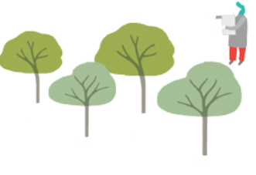
Case Studies
One small thing - microlibrary
Mobilisation – community-asset pub
Growing gains – community garden
Rootedness – digital whip-round service
Networks in the making – communal shed
Scale and tempo – time bank
Stepping into the weave – conservation society

Slide 15
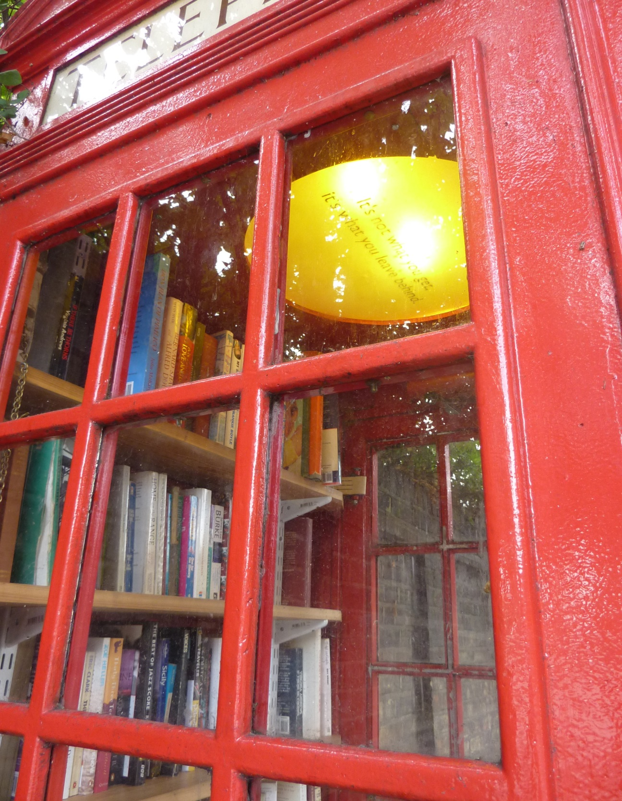
“when you give a book you’re making yourself a bit worse off because you’re giving away some of your possessions, but the overall cumulative thing is that everyone becomes enriched by it: lots of people making a very small sacrifice.”
Sebastian

Slide 16
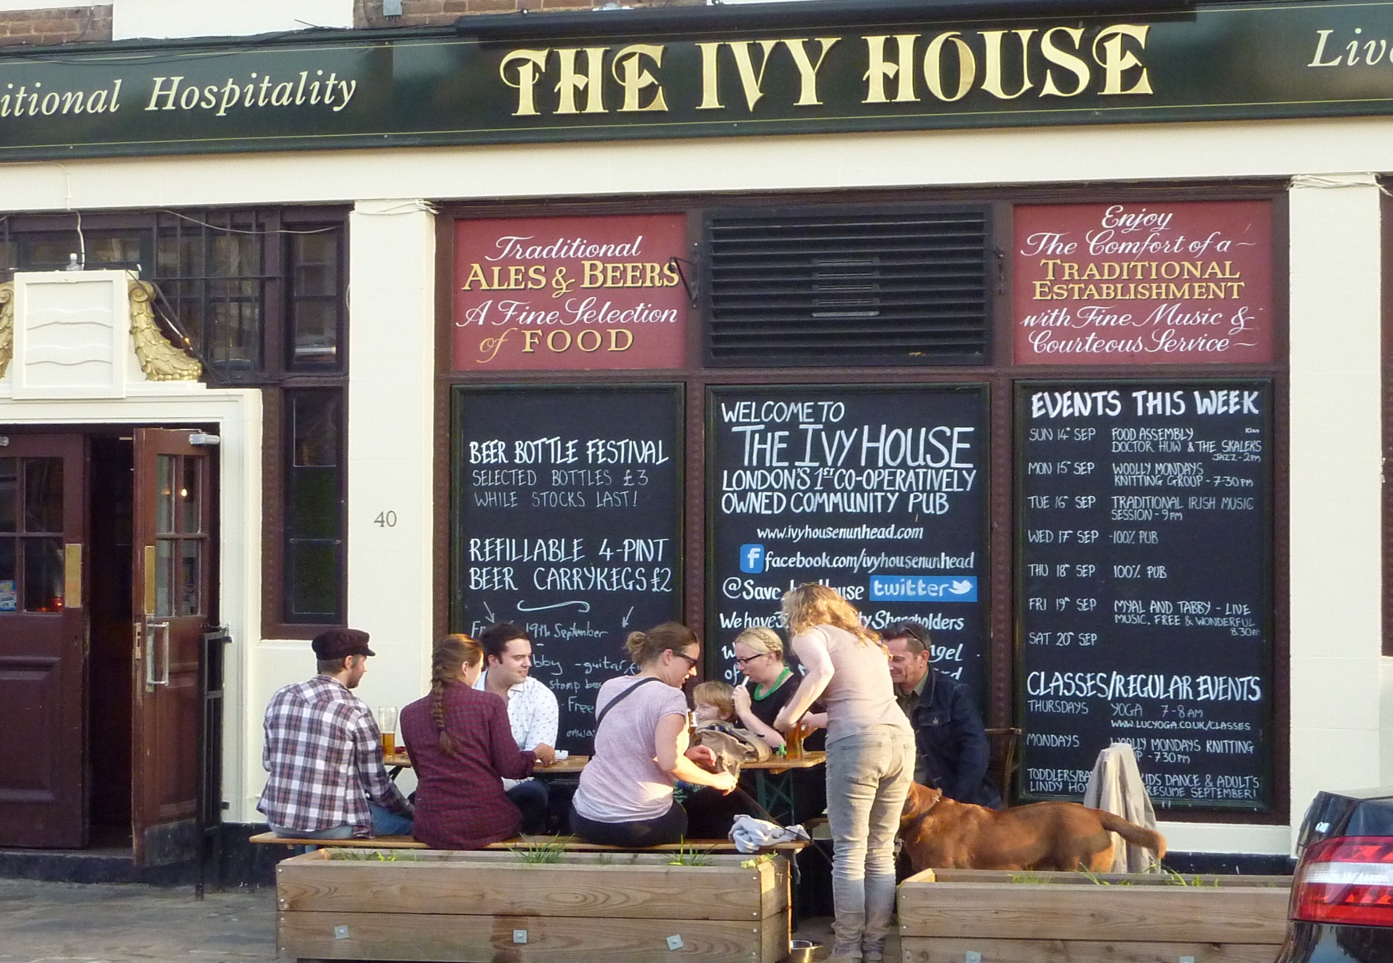

Slide 17
“You go into it not knowing if all your efforts are going to pay off or not, but I would rather do it and it come to nothing than be sitting around in 5 years’ time thinking ‘Oh, I wish I’d tried …blah blah blah’. It’s all very well sitting around complaining about things...
I’ve never done anything like this before, but I thought there was that one chance to try and save it... just have a go.”
Tessa

Slide 18
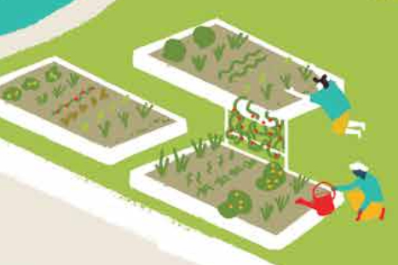
Collective vs individualisitc models?
It’s not always as simple as introducing and vetting
How is sharing understood? As selling spare capacity of owned goods or making assets available to a collective?
ICT is not always used for sharing directly, but for promoting the service or the practices
General platforms like email, Facebook and Twitter are more use on the ground than the custom interfaces
Digital platforms or platforms with
digital enhancement?
Many willing users, but very
discerning about how.

Slide 19
Tactics for Success
One small thing - doing something that doesn’t overstretch the capacity of the people involved;
Mobilisation – taking a broad cross-section of people with you as needs dictate;
Growing gains – giving the time it takes to build social systems around new resources;
Rootedness – aligning with the place and culture you are operating within;
Networks in the making – using existing networks to embed and form partnerships for delivery;
Scale and tempo – linking interests at an individual and small group level with the wider scope of the project;
Stepping into the weave – offering help to other organisations and so creating a culture of support.

Slide 20
Today’s schedule
10.10 Keynote: Russell Belk, Schulich School of Business, York University, Canada
11.00 Break
11.20 Panel 1: Sharing limited resources: time, space, enthusiasms & ‘stuff’
Chair (Ann Light)
Dermot Jones Makerspace
Clare Cowen Brockley Society
Karen Martin The Centre for Architecture and Sustainable
Environment, University of Kent
12.30 Lunch

Slide 21

1.30 Exercise by Fanshen
2.45 Break
3.15 Panel 2: Design to support community cohesion
Chair (Ruth Catlow, Furtherfield)
Kathleen Stokes NESTA
Sarah Bird Timebanking UK
Benita Matofska People Who Share
Zoe Bierman Casserole Club
4.15 Break
4.30 Responses
Chair (Robin Mansell, LSE)
Russell Belk
Jocelyn Cunningham
5.30 Close

Slide 22
Questions to pose…
How is the cultural dimension of people’s experience considered?
What provision is made for people for whom austerity is already a reality?
How is the risk of loss, harm or embarrassment handled?
What dependency is there on existing infrastructure for success?
Does the service encourage us to trust each other or trust the site and its procedures (and the wider legal and economic frameworks of society)?
What model of social relations is embraced in trying to win a critical mass of users?
Does the rhetoric represent the activity of the service?
How are relations with other agencies and organisations established and signalled?
Does the service augment local capacity or replace it?
Does it promote sharing resources without encountering other users or help people meet and share lives as well as spare assets?

